Slide 1
Auxiliary memory

Slide 2
Contents :
What is auxiliary memory
Where we use auxiliary memory
Types of auxiliary memory
Magnetic memory
Magnetic disc
Magnetic tape
Optical disks
Previous year questions

Slide 3
What is Auxiliary memory
Used to overcome limitations of primary memory
It is non volatile
Also known as secondary memory
Larger capacity than main memory

Slide 4
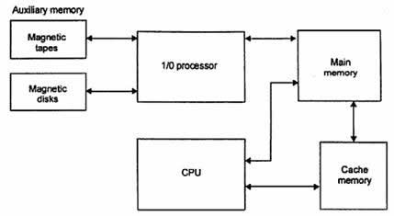
Memory connection in Computer

Slide 5
Magnetic Memory
Permanent type memory
Data can be stored on the Magnetic coated surface by applying electric pulses
There are two techniques of recording longitudinal and vertical
Magnetoresistive sensor used to read the data

Slide 6
Magnetic disks
Read/write data from/To Surface on platters
Surface divided into Tracks and Sectors
Has a disk controller
Has a read and write head

Slide 7
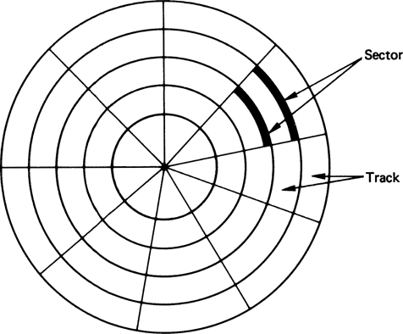

Slide 8
Types of Magnetic disks
Hard disks
Used to store bulk amount of data
storage capacity = No of recording surfaces * no of Track* no of
sectors * no of bytes
Floppy disks
It is a removal device
It is also called as diskette

Slide 9
Magnetic tapes
Used as back up device
Made up of flexible polyester with magnetised material
Sequential access device
Storage capacity = recoding density *length

Slide 10
Optical Disks
Circular disks Coated with thin metal or other material which are highly reflective
Read and write operations using laser beam
Has very storing capacity compared to floppy disks
Direct access device
Storage capacity = No of Sectors *No of Bytes
Examples : CD Rom, DVD ROM

Slide 11
Previous year Questions
How are data read from and Written onto a magnetics disks ? (3m)
A magnetic disks has the following (3m)
Ps = average time to Position the head over the track
R = rotation speed in revolution/sec
Nt = no of bits per track
Ns = no of bit per sector
calculate Tha average time Ta that will take to read one sector

Slide 12
Queries?

Slide 13
Thank you

